Slide 1
Global Transcriptomic Profiling Identifies Differential Gene expression Signatures between Inflammatory and Non-inflammatory Aortic Aneurysms
Aortitis RNA-seq meeting
Thursday, June 8, 2021

Slide 2
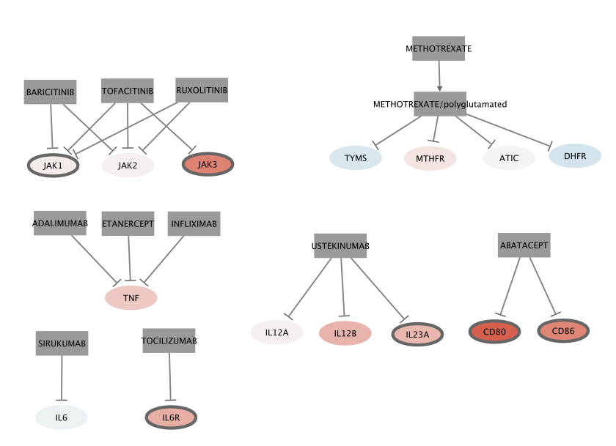
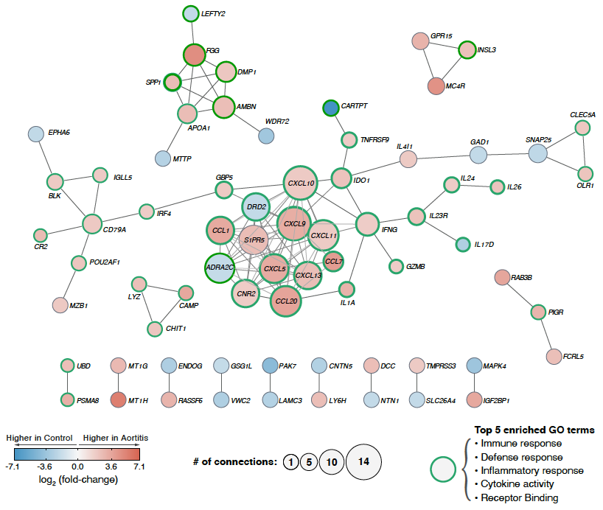
Manuscript outline
Figure 1. Study design, analysis pipeline, and data characteristics.
Figure 2. Volcano plot and functional categories of DEGs
Figure 3. General gene set enrichment analysis for up-regulated/down-regulated DEGs
Figure 4. Heatmap of top 3 enriched GO-terms
(NEW) Figure 5. Gene expression profile of known druggable genes in aortitis (mainly GCA)
SFigure (former Figure 5). Functional protein-protein interaction network of DEGs
Figure 6. PPI-based pharmacogenomic network
1

Slide 3
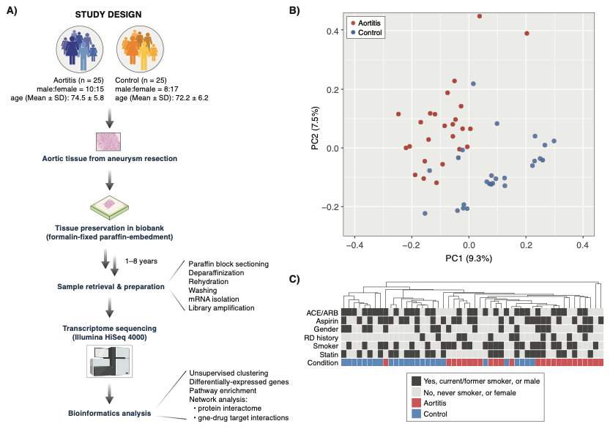
Figure 1.
Figure 1. Study design and data analysis pipeline on genome-wide expression (transcriptome) profiles of inflammatory and non-inflammatory aortic aneurysms.
2

Slide 4
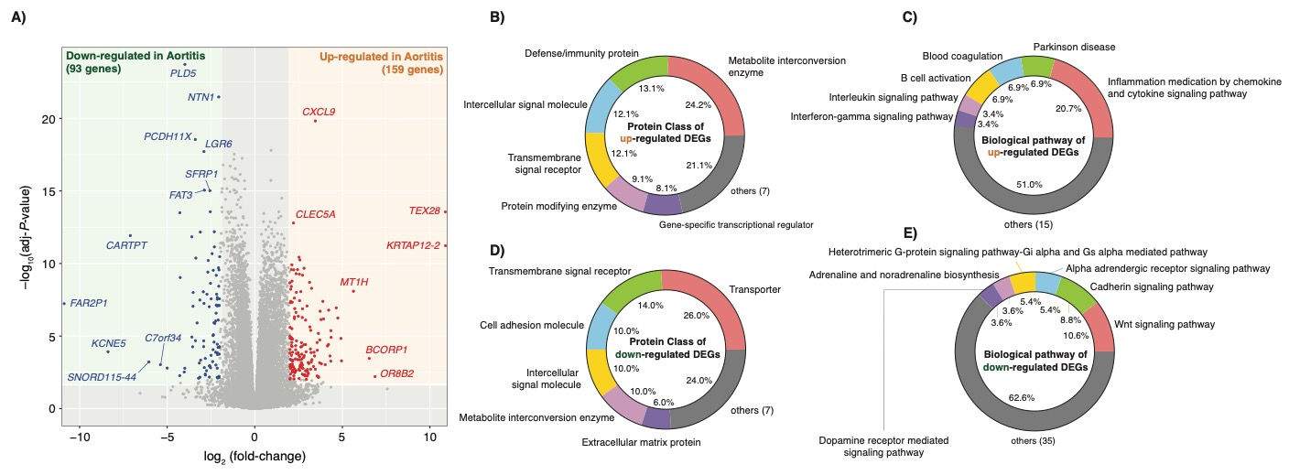
Figure 2.
Figure 2. Differentially-expressed genes (DEGs) and their functional categories reveal transcriptomic signatures of aortitis.
3

Slide 5
Figure 3.
Figure 3. Gene Ontology (GO) enrichment analysis reveals upregulation of immune response genes and downregulation of neuronal activity genes in aortitis.
4

Slide 6
Figure 4.
Figure 4. Gene expression profiles of the top 3 enriched GO-terms identifies key genes involved in dysregulated molecular pathways in aortitis.
5

Slide 7
Investigation of known druggable target genes in aortitis
(NEW) Figure 5
5

Slide 8
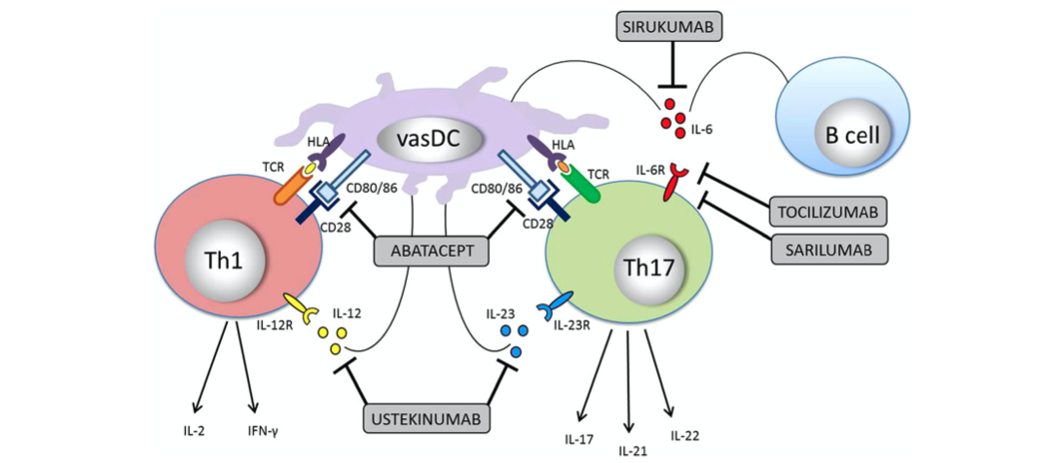
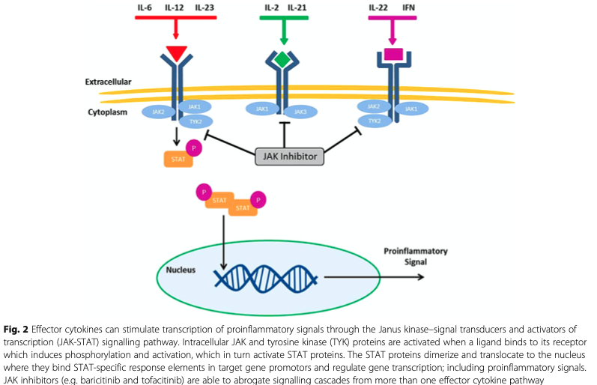
Druggable genes
Focusing on druggable genes that were mentioned by Koster et al., and others
TOCILIZUMAB: IL6R
SARILUMAB: IL6R
SIRUKUMAB: IL6
ABATACEPT: CD86, CD80
USTEKINUMAB: IL12B, IL12A, IL23A
+ METHOTREXATE, INFLIXIMAB, ETANERCEPT, ADALIMUMAB
6

Slide 9
Known druggable genes
Figure 5. (tentative legend) Gene expression profile of known druggable genes in aortitis (mainly GCA)
Drug interaction info. from:
DGIdb
Koster et al.
Gremese et al.
Bursi et al.
Cronstein et al.
Dejaco et al.
Harrington et al.
Nodes with thick boarders, adj-P < 0.05
7

Slide 10
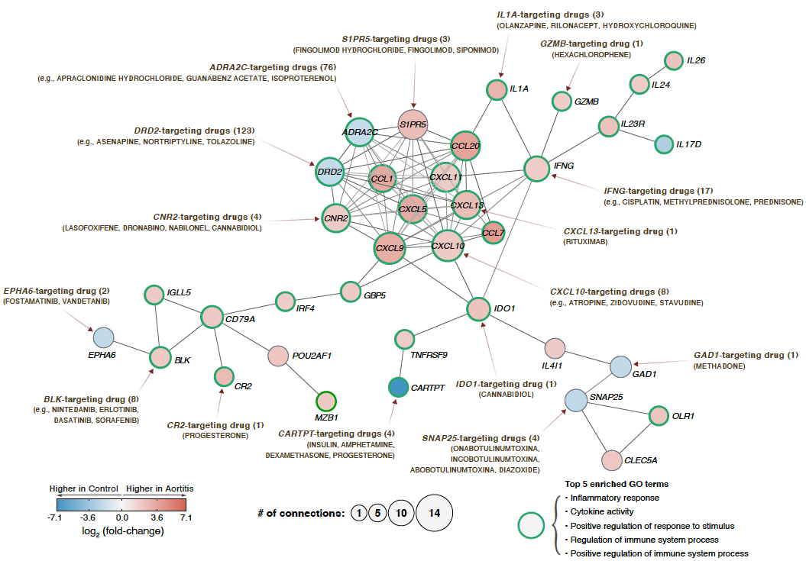
Figure 6.
Figure 6. PPI-based pharmacogenomic network uncovers the gene-drug interaction landscape in aortitis.
8

Slide 11
Misc.

Slide 12
Represents DEGs between HC vs. GCA; linear model coefficients, P < 0.05
gene | log2fc | adj-p
IL6 | -0.1045204 | 0.86836651
IL6R | 0.85999626 | 0.00047757
IL6ST | -0.0068843 | 0.95751675
gene | log2fc | adj-p
IL12A | 0.0840343 | 0.93818957
IL12B | 0.79428854 | 0.54752627
IL12RB1 | 1.36191321 | 1.09E-05
IL12RB2 | 0.64803779 | 0.00408705
gene | log2fc | adj-p
IL23A | 0.75477374 | 0.02186471
IL23R | 2.47053579 | 0.00013769
gene | log2fc | adj-p
IL17A | 0.11476674 | 0.97522326
IL17B | -1.5224569 | 0.04736021
IL17C | -0.2577331 | 0.89606932
IL17D | -2.8197242 | 0.00489863
IL17F | -0.500024 | NA
IL17RA | 0.44970042 | 0.00065388
IL17RB | 0.25954661 | 0.13745021
IL17RC | -0.7027821 | 9.69E-11
IL17RD | -0.4548054 | 0.01037553
IL17RE | -0.0277863 | 0.90638622
gene | log2fc | adj-p
IL2 | 1.26183818 | 0.19806544
IFNG | 2.00824505 | 1.04E-05
gene | log2fc | adj-p
IL21 | 2.17150698 | 0.20229954
IL22 | 1.70793267 | 0.06369482

Slide 13
Pro-inflammatory cytokines
IL1
INF (alpha, beta, gamma)
IL18
GCSF
gene | log2fc | adj-p
IL1A | 3.19111325 | 4.04E-06
IL1B | 1.36357724 | 0.00079353
gene | log2fc | adj-p
IFNA1 | -0.8004634 | NA
IFNA10 | -0.7437551 | 0.8833184
IFNA13 | 0.40983495 | NA
IFNA14 | 0.37849544 | NA
IFNA16 | -0.3910468 | NA
IFNA17 | 7.82868379 | NA
IFNA2 | -0.1455471 | 0.96329576
IFNA21 | 4.34575443 | 0.0334936
IFNA4 | 4.51193751 | NA
IFNA5 | -0.3684258 | 0.80875735
IFNA6 | 0.65050927 | NA
IFNA7 | -0.7077727 | NA
IFNA8 | -2.144489 | NA
IFNAR1 | 0.3081466 | 0.00032717
IFNAR2 | 0.73424258 | 3.32E-12
IFNB1 | 0.93172685 | 0.55172424
IFNG | 2.00824505 | 1.04E-05
IFNGR1 | 0.56322598 | 6.98E-06
IFNGR2 | 0.53182295 | 1.50E-07
gene | log2fc | adj-p
IL18 | 1.54644534 | 3.15E-15
IL18BP | 0.33946572 | 0.1008962
IL18R1 | 0.73117063 | 0.00059902
IL18RAP | 0.37786144 | 0.40068404
gene | log2fc | adj-p
CSF3 | -0.7876437 | 0.6070498
IL11
gene | log2fc | adj-p
IL11 | -0.1075452 | 0.96192647
IL11RA | -0.5351242 | 3.71E-05
IL17
gene | log2fc | adj-p
IL17A | 0.11476674 | 0.97522326
IL17B | -1.5224569 | 0.04736021
IL17C | -0.2577331 | 0.89606932
IL17D | -2.8197242 | 0.00489863
IL17F | -0.500024 | NA
IL17RA | 0.44970042 | 0.00065388
IL17RB | 0.25954661 | 0.13745021
IL17RC | -0.7027821 | 9.69E-11
IL17RD | -0.4548054 | 0.01037553
IL17RE | -0.0277863 | 0.90638622
TNF (alpha, beta)
gene | log2fc | adj-p
TNF | 0.55397877 | 0.20024196
LTA | 0.93418484 | 0.26830238
IL6
gene | log2fc | adj-p
IL6 | -0.1045204 | 0.86836651
IL6R | 0.85999626 | 0.00047757
IL6ST | -0.0068843 | 0.95751675
IL8
gene | log2fc | adj-p
CXCL8 | -0.0858684 | 0.90079153
Notes:
https://www.thermofisher.com/us/en/home/life-science/cell-analysis/cell-analysis-learning-center/immunology-at-work/proinflammatory-cytokines-overview.html#references

Slide 14
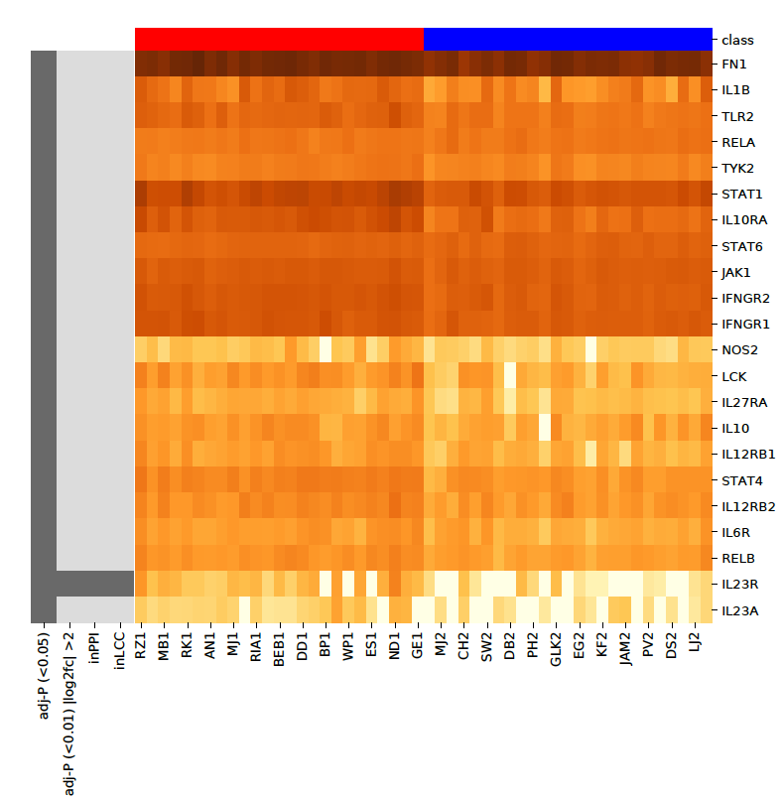
IL12A, IL12, IL23A interacting genes
*genes that are targeted by USTEKINUMAB
Among 7469 DEGs (adj-P < 0.05)
22 DEGs are closely related with
USTEKINUMAB targeting genes
While,
1 are associated with PPI-Network
1 are associated with LCC

Slide 15
Terminology
PPI nodes: Proteins.
PPI edges: Predicted functional associations between two proteins.
indicates the presence of fusion
neighborhood
co-occurrence
experimental text-mining
database evidence
co-expression evidence.

